Slide 1

Image Forgery Detection
Avneet Kaur (1900635)
Basav Bamrah (1900636)
Bina Kumari ((1900637)
Binwant Singh (1900638)
Baba Banda Singh Bahadur Engineering College

Slide 2
Table of Contents
01
02
03
04
Introduction
Introduction to problem statement
Methods of Forgery Detection
Traditional and Deep Learning
Results
Results of different techniques
Conclusion
Acknowledgement
Literature Cited
05
06

Slide 3
01
INTRODUCTION
Image Forgery Detection

Slide 4

Image Forgery
Throughout the last few decades, there has been a sharp rise in the use of digital images. Virtually every facet of life now makes use of digital photos. Many documents that must be filed online require images in the form of soft copies, and a lot of images are shared on social media every day.
Editing or altering a digital image has become more simpler thanks to the rapid advancement of digital image processing technology and the prevalence of digital cameras, even for a novice forger.

Slide 5
Image Forgery: A Problem
Forgeries are dangerous because they are frequently difficult to spot as fakes. As a result of digital forgeries, the victims of these activities may suffer financial loss as well as a loss of reputation
The technology of digital resource repositories is moving at a much faster rate due to social networking sites, making it very difficult to find the original source of the forgeries
The originality and validity of financial, legal, and medical documents and data, as well as other high-value assets, is crucial and imperative.

Slide 6
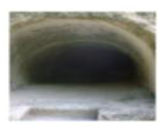
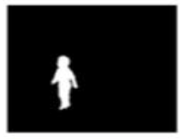
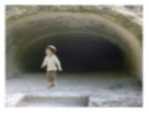
Original Image
Editing Algos + Other image
Forged Image
An original Image is taken
Editing algorithms and splicing other imager on original image
Final forged image formed

Slide 7
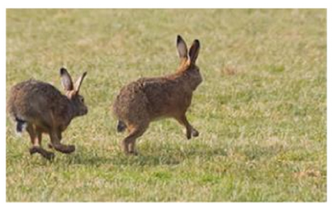
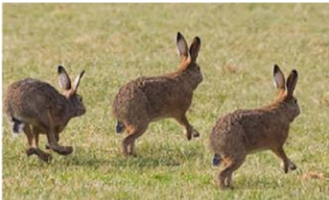
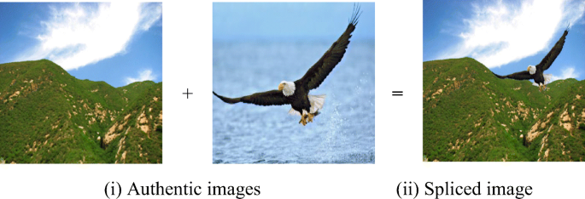
Types Of Image Forgery
Copy-Move Forgery
Splicing Forgery
Copy-move forgery is a specific type of image tampering where a part of the image is copied and pasted somewhere else in the image with the intent to cover an important image feature.
In image splicing the contents of host images are modified by copying and pasting the contents from other images.
a) Original Image b) Edited Image

Slide 8
02
Methods of Forgery Detection

Slide 9
Methods For Forgery Detection
Forgery Methods
Deep Learning Methods
Traditional Methods
Recompression
(CNN)
Pixel Based
(Neural Networks)
Lighting inconsistency
Color abbreviation

Slide 10
Traditional Methods
The term "classic" or "traditional" approaches is frequently used to describe conventional passive methods.
Traditional machine learning methods, such as clustering, support vector machines (SVM), linear/logistic regression, random forests, and so on are used for training the model.
The statistical attributes derived from the image such as lighting inconsistencies [3], chromatic aberration[4],device specific parameters, resampling etc, are used in previous systems to conduct image forgery detection.

Slide 11
Traditional Methods
Lighting inconsistency: In an image, the lighting direction in various parts of the image is consistent whereas if it is an image composite, the lighting directions in different parts of image will not match therefore this inconsistency in lighting direction is a trace for detecting forgery in an image.
Color abbreviation: Color channel contraction and expansion with respect to one another can be used to model aberration. This aberration frequently persists throughout the entire image. This aberration can be discovered to be inconsistent in certain areas of a picture when it has been altered, indicating that the image has been faked
These techniques are implemented using algorithms like Support Vector Machine(SVM), linear/logistic regression, random forests

Slide 12
Deep Learning Methods
Deep learning techniques have become incredibly popular and have been used to solve a wide range of scientific issues. This is because it has been demonstrated that they excel in classification difficulties as well as regression and segmentation problems.
CNN has already proven to have exceptional potential in a number of computer vision applications. Due to the diverse origins of the images, a range of distortions appear when a piece of an image is transferred from one to another. CNNs can spot these distortions in falsified images even though they may be invisible to the unaided eye.

Slide 13
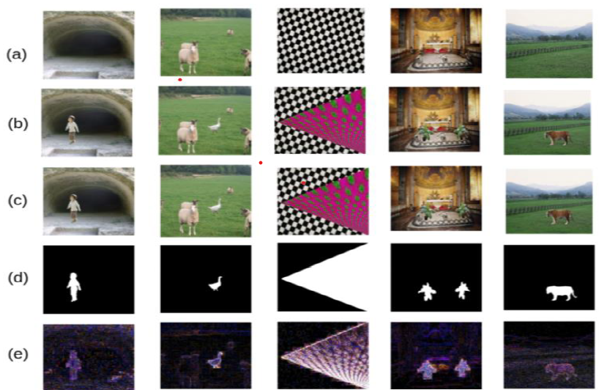
Recompression: In [2] , the image is compressed using JPEG compression and the compressed image is subtracted from the original image. Due to the compression difference, the resulting image highlights the forged or sliced part.This CNN based model detects both copy-move and splicing forgeries.
Original Image
Forged Image
Compressed Image
Mask of image used to edit original image
Subtracted Image

Slide 14
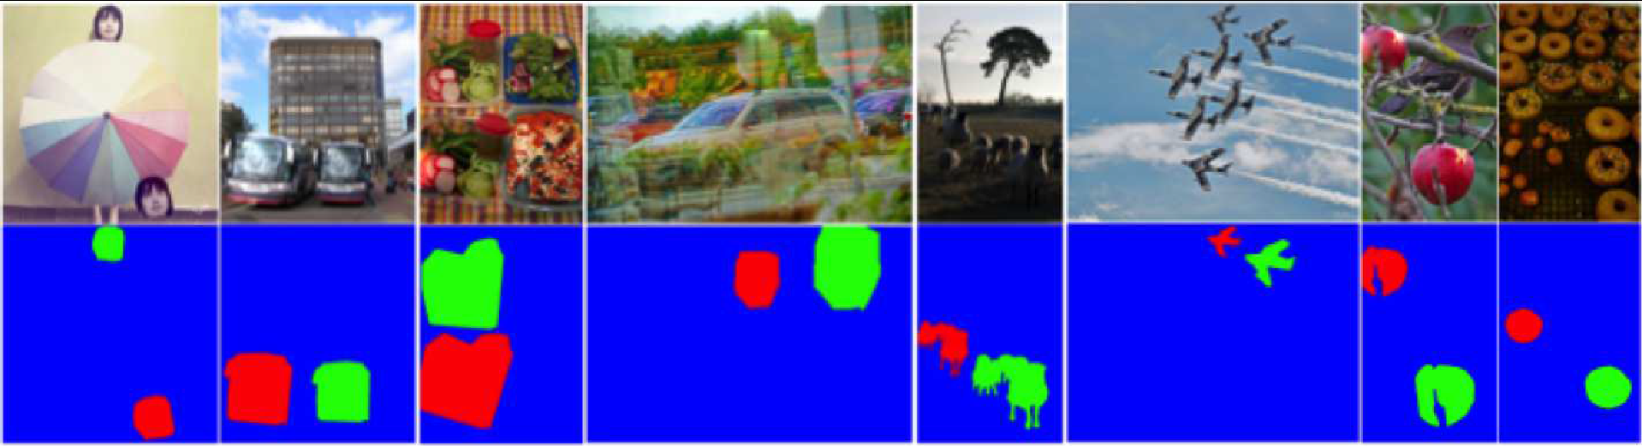
Pixel Based: In [8] , one branch of Deep neural network(DNN) is used to detect manipulated regions , while other branch is used cloned regions and finally fusion of both features is used to predict pixel level localization differentiating pristine, source copy, and target copy classes. This busternet based DNN detects the copy-move forgery.
Pixel colors blue, green and red denotes pristine, source and target copy classes, respectively.

Slide 15
Results
Sr. No. | Author | Method Used | Forgery Type | Model | Accuracy
1. | Ali S.S.[1] | [1] Recompression and CNN Quality = 85% Quality = 90% Quality = 95% Quality = 98% | Copy move and Image splicing | CNN | 87.71 91.31 91.83 92.23
2. | Wu Y, Abd-Almageed W, Natarajan P | [7] BusterNet (pixel based) | Copy-move | VGG16 | 76% - 80.49%
3. | Shi, Y.Q., Chen, C., Chen, W [7] | Moments of characteristic functions of wavelet subbands | Image splicing | SVM with RBF kernel | 91.87%
4. | Fu et al. [5] | HHT and Wavelet Decomposition | Image splicing | SVM | 80.15%
5. | Ng, T., Chang, S., Sun, Q [6] | Bicoherence features | Image splicing | SVM | 62-70%
6. | Abdalla.Y Iqbal. M.T and Shehata M [2] | Jpeg Compression | Copy- move | CNN | 88.26% - 90.1%

Slide 16
Conclusion
In this paper an overview of most accurate copy-move and splicing detection techniques that have been developed recently using Deep learning is presented. Various existing approaches such as BusterNet , Recompression have been examined.
Survey on techniques using deep learning as these are more accurate in generalizing the data and has better performance as compared to traditional techniques are focussed in this paper.Summarised overview of deep learning techniques will be useful and helpful to students and researchers in this field.

Slide 17
Acknowledgement
Special thanks to our teachers and supervisors to who gave us the golden opportunity to do this survey on the topic "Image Forgery Detection: a survey of recent approaches", which also helped us in doing lot of research and we came to know so many new things.
We are really thankful to them.
Secondly,we would like to thank Shri Guru Granth Sahib World University for providing us the platform to test and enhance our knowledge.
THANKS TO EVERYONE WHO HELPED.

Slide 18
Literature Cited
[1] Ali S.S. , Ganapathi I.I, Vu N. , Ali S. D., Saxena N and Werghi N. 2022 ‘Image Forgery Detection Using Deep Learning by Recompressing Images’ MDPI publication
[2] Abdalla Y, M. Iqbal.T and Shehata M 2019 ‘Convolutional Neural Network for Copy-Move Forgery Detection’ MDPI
[3] Johnson MK, Farid H. 2005, ‘Exposing digital forgeries by detecting inconsistencies in lighting’. Proceedings of the 7th workshop on ACM Multimedia and Security Workshop, New York, pp. 1– 10
[4] Johnson MK, Farid H.2006, ‘Exposing digital forgeries through chromatic aberration’. In Proceedings of the 8th workshop on ACM Multimedia and Security Workshop, Geneva, Switzerland, pp. 48–55
[5] Li, X., Jing, T., Li, X. 2010 ‘Image splicing detection based on moment features and Hilbert-Huang transform’ . IEEE Int. Conf. Inf. Theory Inf. Secur
[6] Ng, T., Chang, S., Sun, Q. 2004 ‘Blind detection of photomontage using higher order statistics’. In: IEEE International Symposium on Circuits System, pp. 7–10
[7] Shi, Y.Q., Chen, C., Chen, W.2007 ‘A natural image model approach to splicing detection’. In: Proceedings of 9th Workshop Multimedia Security, pp. 51–62
[8] Wu Y, Abd-Almageed W, Natarajan P. 2018 ‘Busternet: detecting copy-move image forgery with source/target localization’. Proceedings of the European conference on computer vision (ECCV), pp 168–184.

Slide 19
Thanks!

